Slide 1

Identifying TRAFFIC Congestion Precursors Using Machine Learning Methods
Nishu Choudhary
Dr. Angshuman Guin & Dr. Michael P. Hunter
March 2022

Slide 2

Overview
Motivation-Problem overview
Site Description
Problem Formulation
Dataset Filtering
Machine Learning Classifiers
Results
Limitations and Future Directions

Slide 3
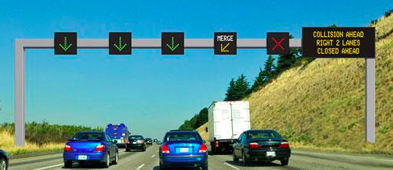
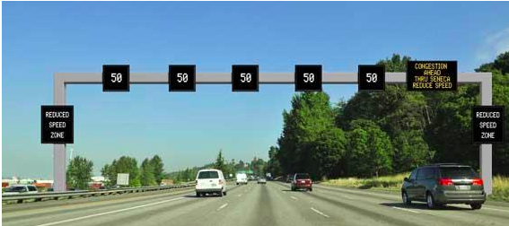
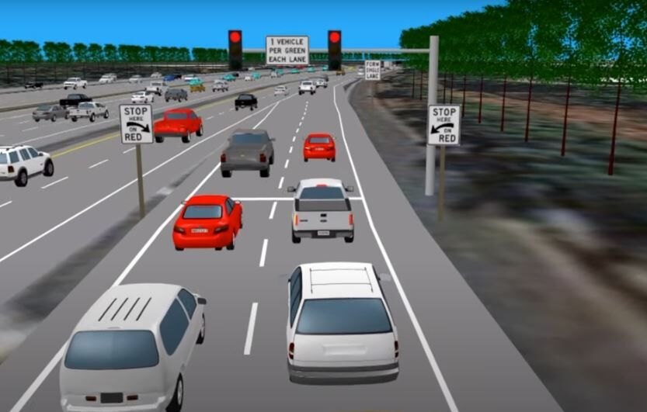
Motivation
Current Practices –reactive to traffic state
Prediction Model- allow traffic management agencies to take preemptive actions
Dynamic Message Sign: WSDOT
Source: https://wsdot.wa.gov/travel/operations-services/active-traffic-and-demand-management
Variable Speed Limit: WSDOT
Source: https://wsdot.wa.gov/travel/operations-services/active-traffic-and-demand-management
Ramp Metering: Maryland’s I-270
Source: https://wjla.com/news/local/flashing-yellow-lights-maryland-ramp-metering-system-i-270

Slide 4
Background
Recurring congestion- spatiotemporal patterns¹
Non-recurring congestion- incident, weather¹
Identify precursor for imminent traffic congestion
Previous studies- regression based prediction traffic flow, speed or travel time²
1.Jessica McGroarty, Recurring and non-recurring congestion: Causes, impacts, and solutions. Neihoff Urban Studio–W10, University of Cincinnati (2010)
2. Nishant Kumar, Martin Raubal, Applications of deep learning in congestion detection, prediction and alleviation: A survey, Transportation Research Part C: Emerging Technologies, Volume 133, 2021, 103432, ISSN 0968-090X, https://doi.org/10.1016/j.trc.2021.103432.

Slide 5
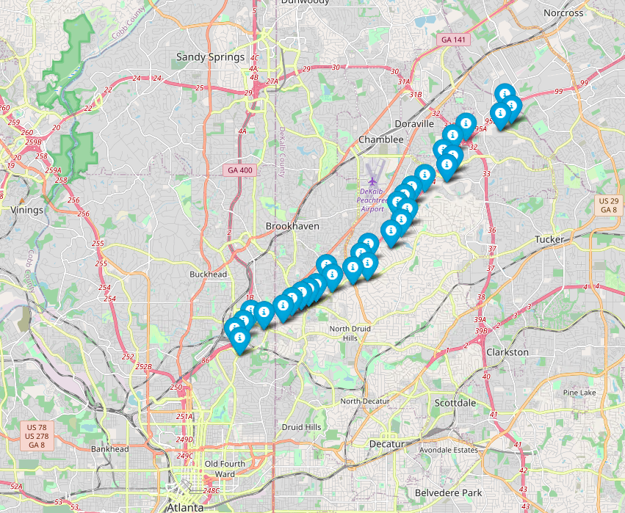

Site Description-1
N
3953
3954
3950
3945
3940
3935
3930
Data by © OpenStreetMap, under ODbL
I85 Freeway section: From Buford Hwy Exit to Clairmont Rd. NE
Northbound Direction
Video Detection System Device IDs [3930-3940]

Slide 6
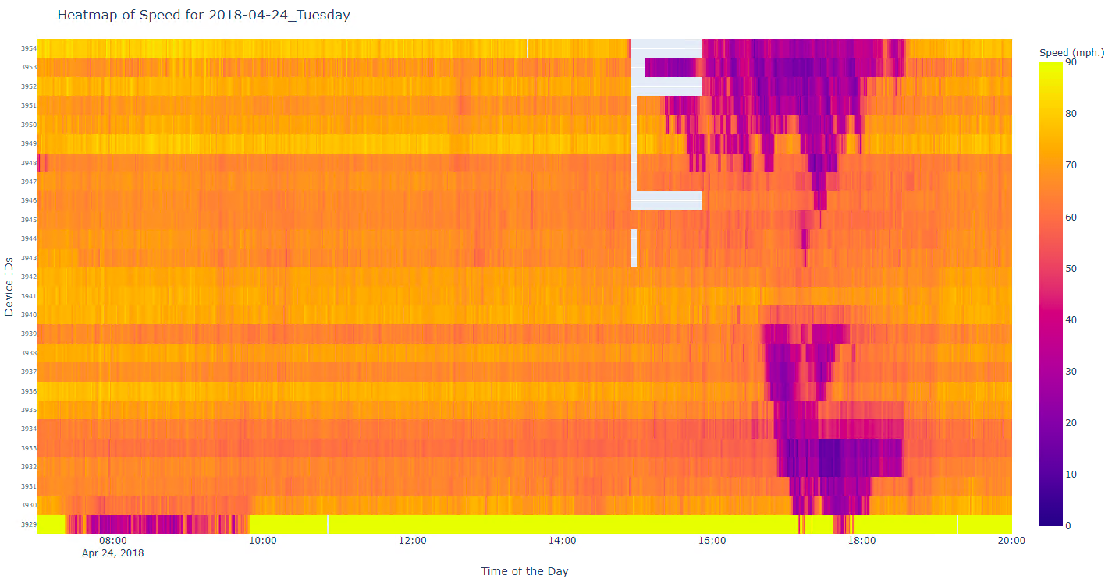
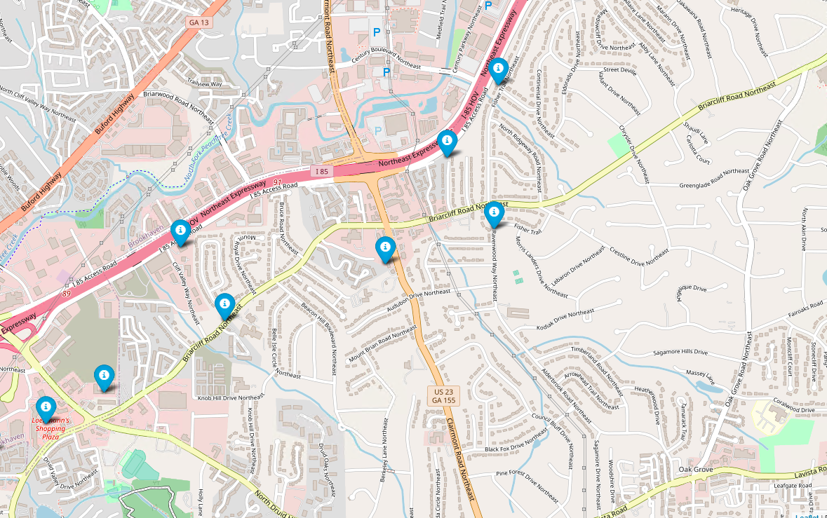
Site Description-2
04/24/2018
N
Recurrent Bottleneck
Direction of travel
Average speed (mph.) for I-85 freeway section on 04/24/2018
N
Data by © OpenStreetMap, under ODbL

Slide 7
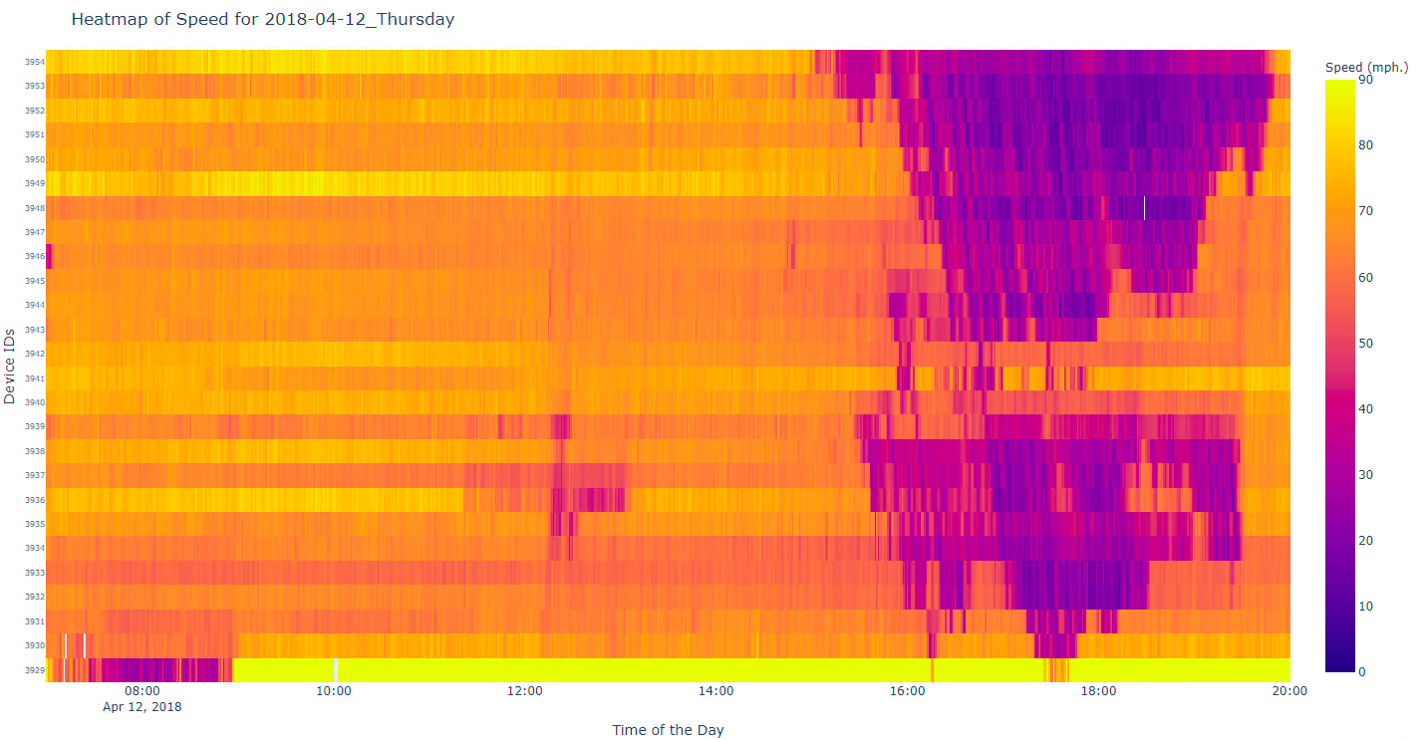
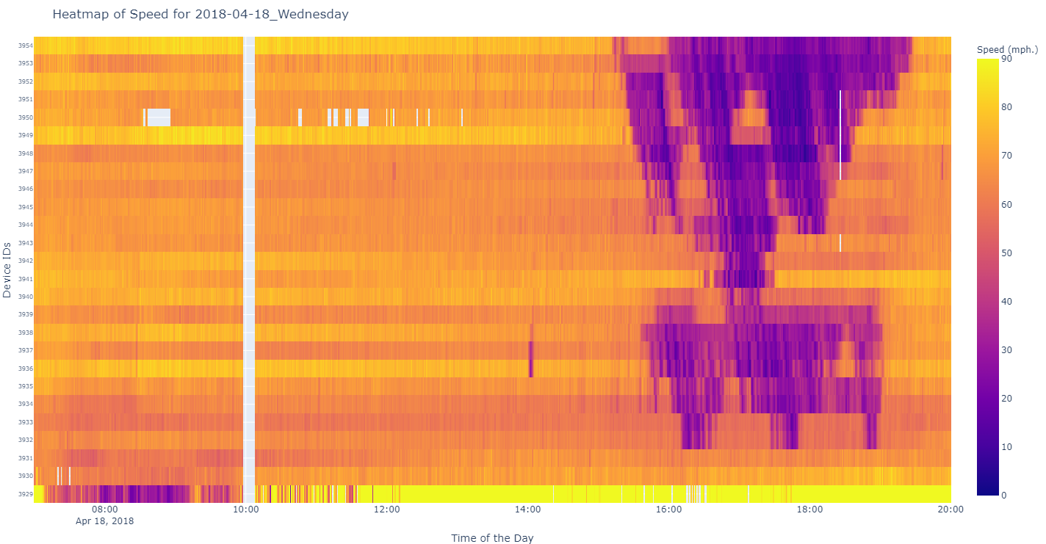
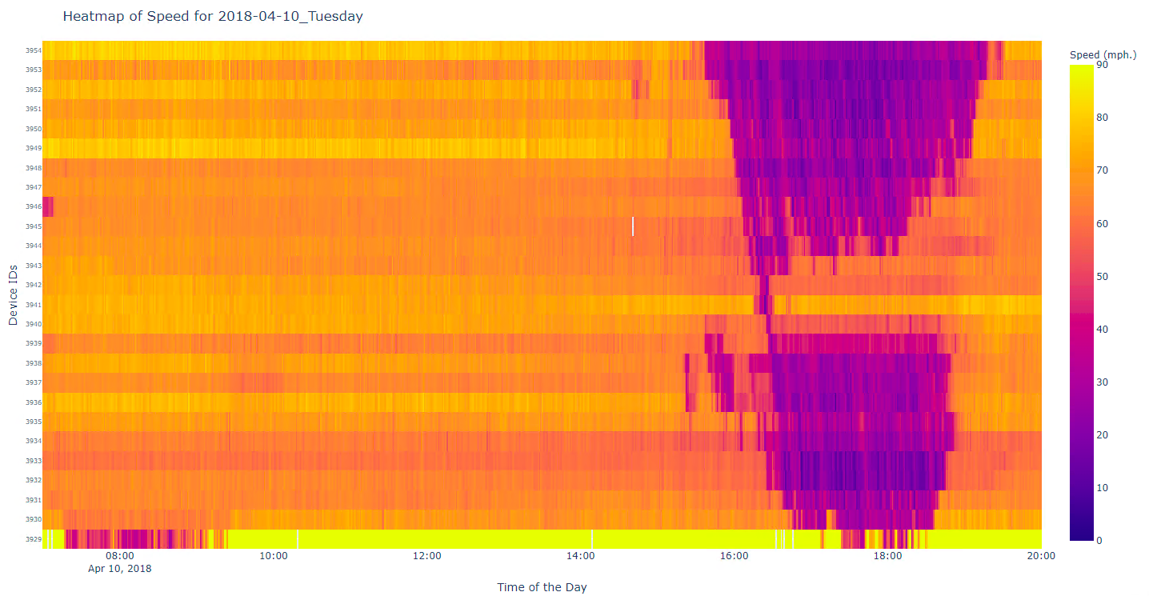
Recurrent Bottleneck
04/12/2018
04/18/2018
04/10/2018
Average speed (mph.) for I-85 freeway section

Slide 8
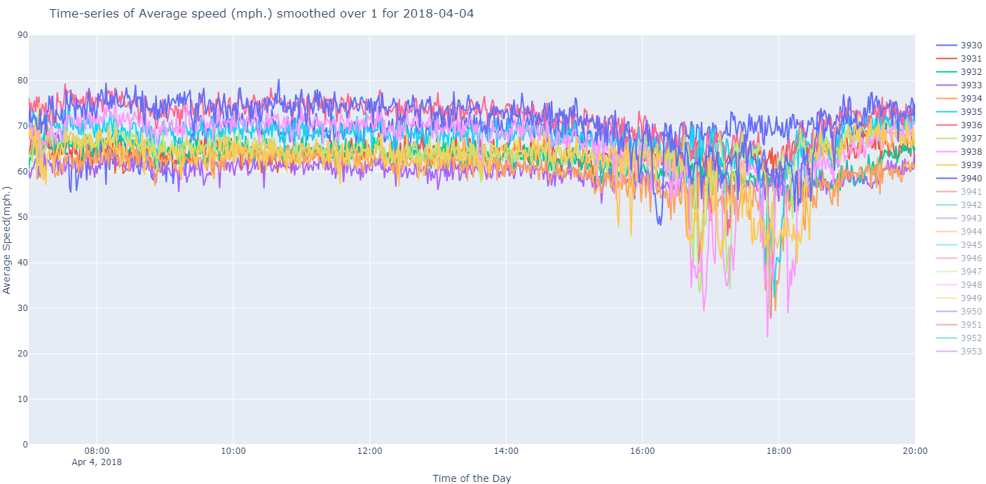
Problem Formulation
Discard the data
Label Zero
Last 5-minutes: Label One
Speed drop detected in the section
Average speed (mph.) over 1-min for the selected freeway section on 04/04/2018
Pre-congestion period 6 min to 31.5 min³
3.Persaud B, Yagar S, Brownlee R. Exploration of the Breakdown Phenomenon in Freeway Traffic. Transportation Research Record. 1998;1634(1):64-69. doi:10.3141/1634-08

Slide 9
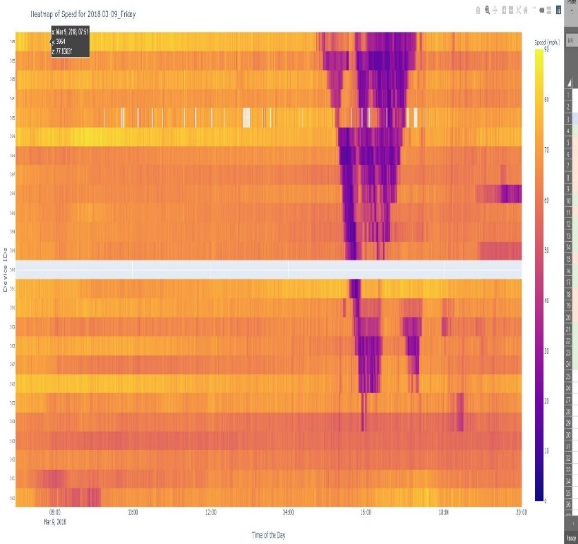
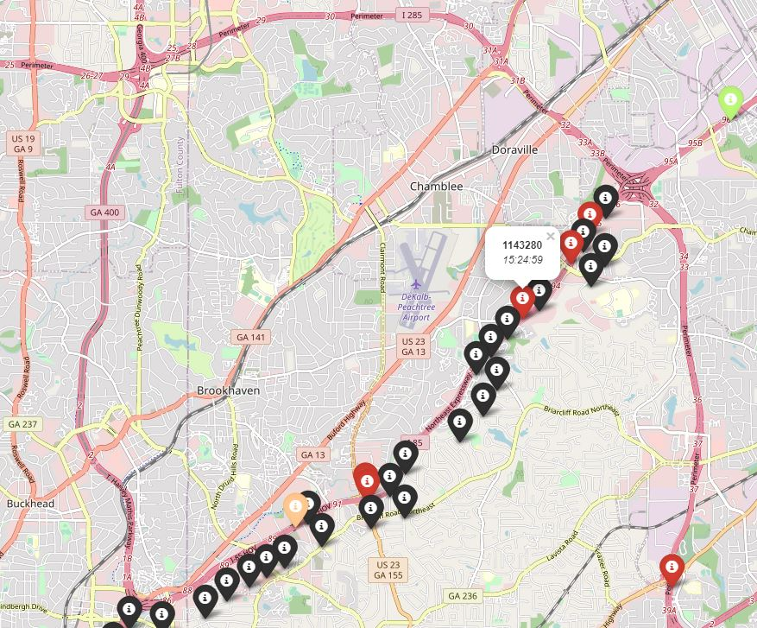
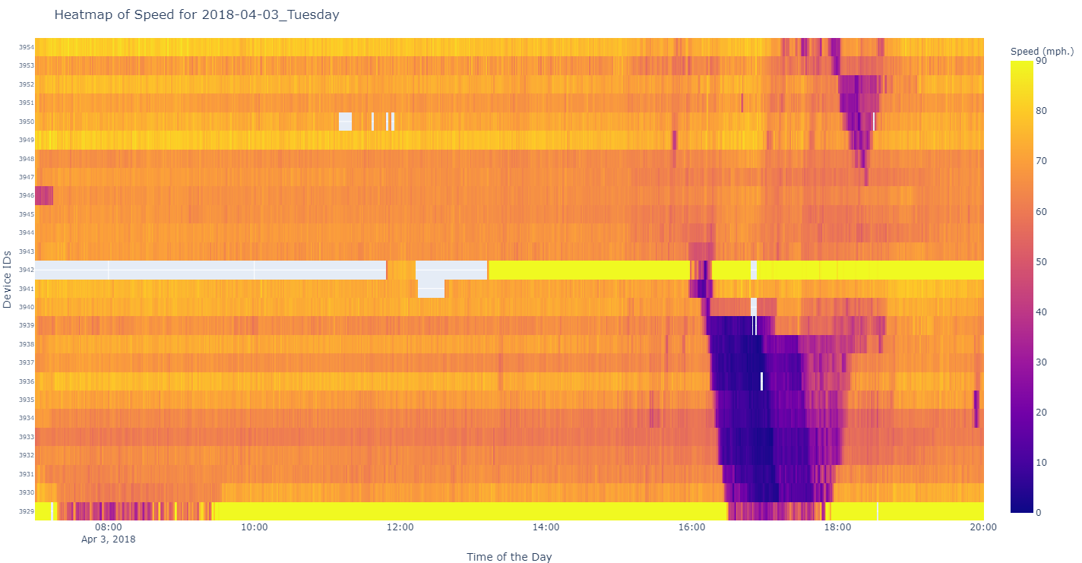
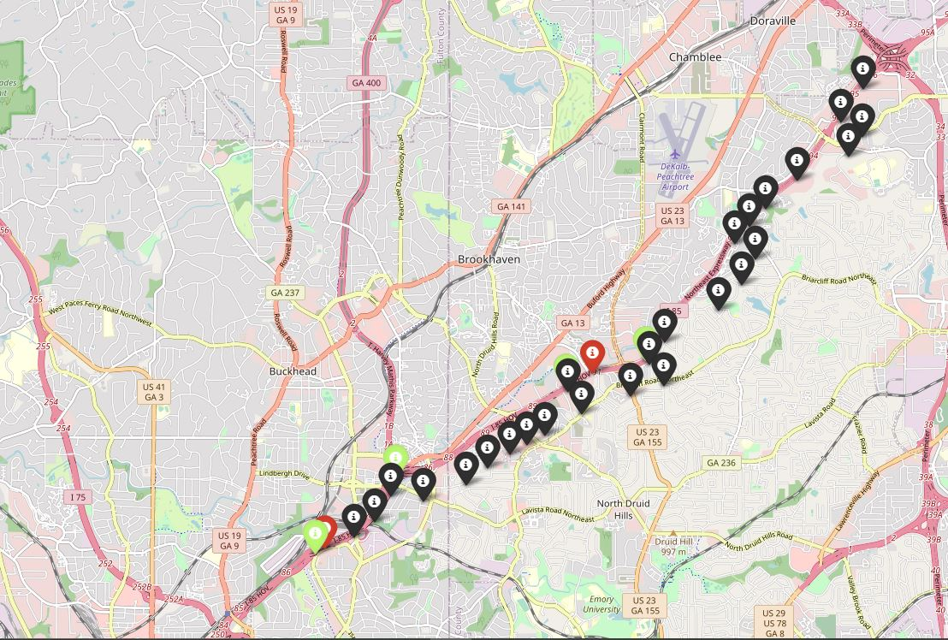
Dataset Filtering
Rules:
Remove congestion events where bottleneck is located outside the site [3940-3930]
Incident related congestion events removed from data. But, if the start time of an incident later than start of congestion, include the event
Exhibit for Rule #1
Exhibit for Rule #2
Incident

Slide 10
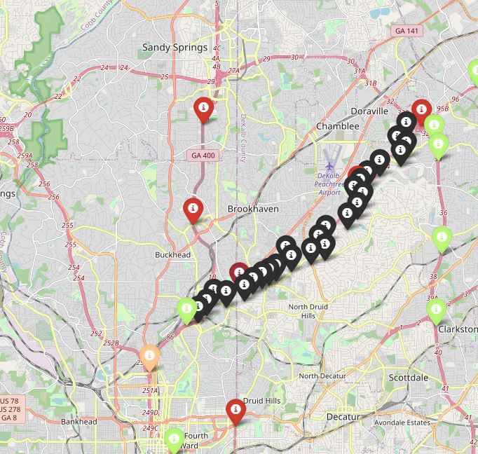
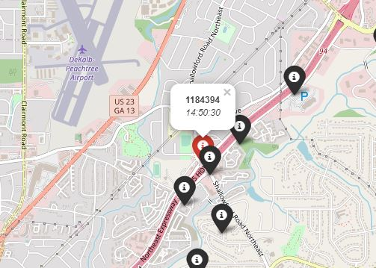
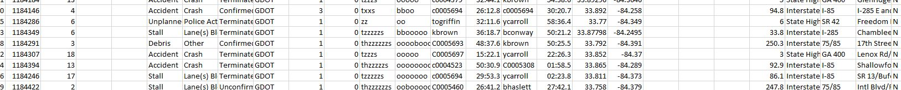
Incident cross-check
Devices denoted by black markers
Incidents: other colors
Accident = Red
Stall = Light-green
Debris = Beige
Event ID
Start-time

Slide 11
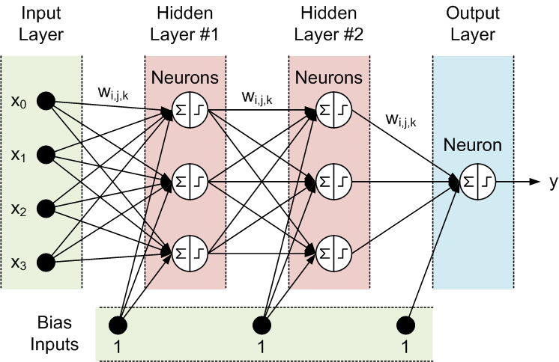
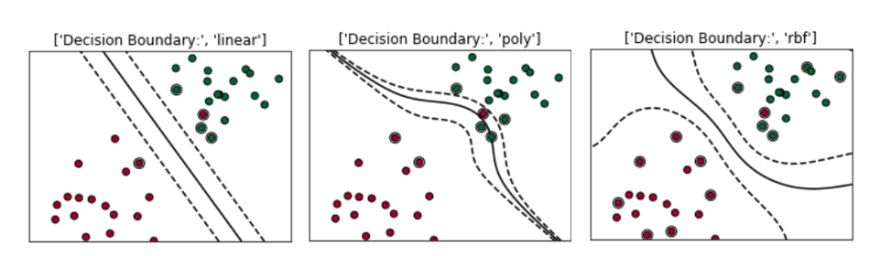
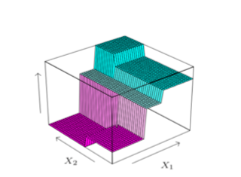

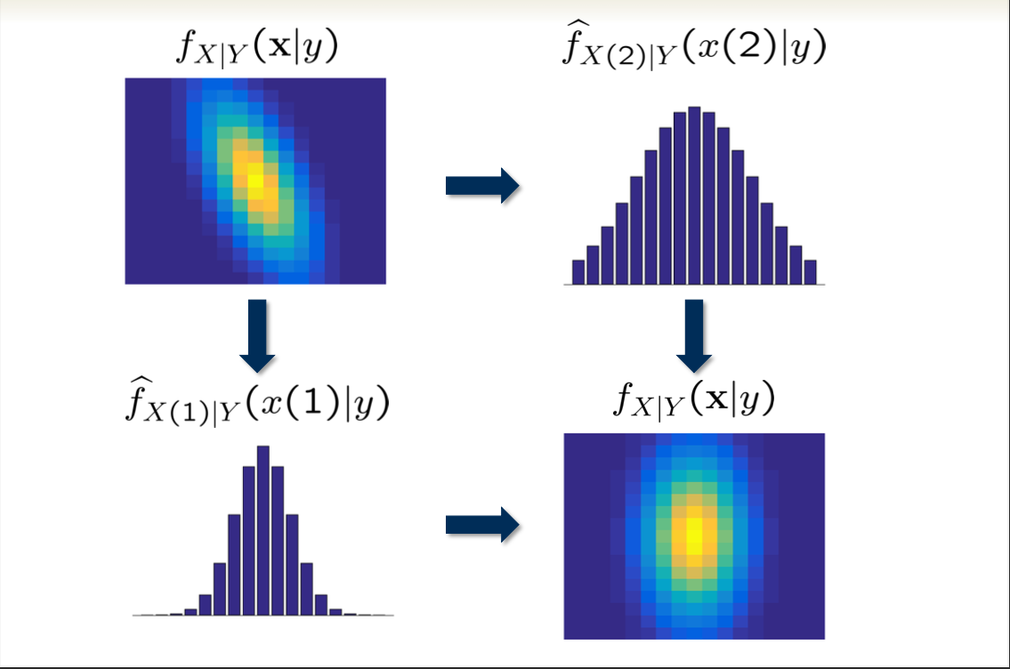
Machine Learning Classifiers
Discriminative: estimate the decision boundary
Neural Network: feedforward network to approximate a function
Support Vector Machines⁴
Source:https://towardsdatascience.com/support-vector-machine-simply-explained-fee28eba5496
Neural Network⁷
^{Source: Lan, 2020}
Tree-based: break input space into regions
Generative: model joint probability distribution
Decision Trees⁶
^{Source: Lan,2020}
Random Forest⁶
^{Source: Lan,2020}
Naïve Bayes Classifier⁵
^{Source: Davenport, 2022}
Notes:
4. https://towardsdatascience.com/support-vector-machine-simply-explained-fee28eba5496
5. Dr. Mark Davenport, MD. (2022, February 16). Logistic Regression and Naïve Bayes . Electrical and Computer Engineering, Georgia Institute of Technology. https://mdav.ece.gatech.edu/ece-6254-spring2022/notes/10-LR-NB.pdf
6. Dr. George Lan, GL. (2020, April 28). Decision Trees and Random Forest. Industrial and Systems Engineering, Georgia Institute of Technology
7. Dr. George Lan, GL. (2020, March 16). Neural Networks-Lecture#13. Industrial and Systems Engineering, Georgia Institute of Technology.

Slide 12
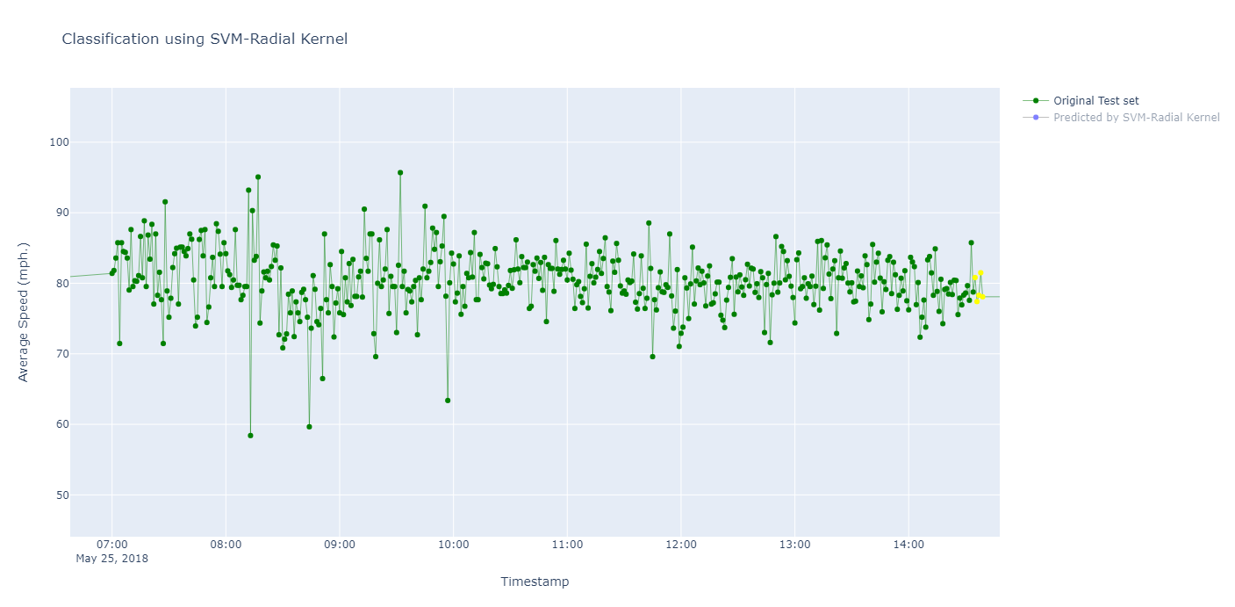
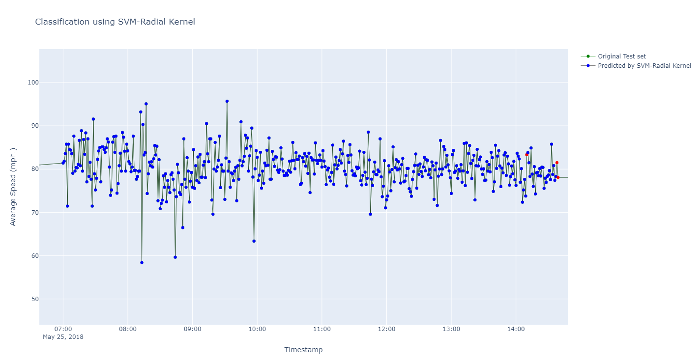
Results
March | 11 days
April | 15 days
May | 18 days
Training | 36 days
Testing | 8 days
Class Distribution
Training | {‘1’: 180 ‘0’: 17396} | 1.02%
Testing | {‘1’: 40 ‘0’: 3510} | 1.13%
Original Labeling 05/25/2018
Predicted Labeling 05/25/2018
Label: zero
Predicted Label: zero
Label: one
Predicted Label: one

Slide 13

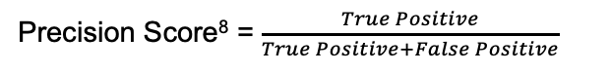
Results
March | 11 days
April | 15 days
May | 18 days
Machine Learning Classifier | Accuracy | Recall | Precision
SVM-polynomial Kernel | 0.61 | 0.23 | 0.26
SVM-Radial Kernel | 0.61 | 0.23 | 0.33
Neural Network | 0.58 | 0.18 | 0.23
Decision Tree Classifier | 0.90 | 0.90 | 0.10
Random Forest Classifier | 0.96 | 1.00 | 0.14
Naive Bayes classifier | 0.94 | 1.00 | 0.09
Training | 36 days
Testing | 8 days
Class Distribution
Training | {‘1’: 180 ‘0’: 17396} | 1.02%
Testing | {‘1’: 40 ‘0’: 3510} | 1.13%
Precision Score⁸ = $\frac{True Positive}{True Positive+False Positive}$
Recall Score⁸ = $\frac{True Positive}{True Positive+False Negative}$
Notes:
8. Scikit-learn: Machine Learning in Python, Pedregosa et al., JMLR 12, pp. 2825-2830, 2011.

Slide 14
Limitations & Future Directions
Increase the dataset size
Explore Deep Learning models
Thank you for your time
Contact: nishuchoudhary@gatech.edu

